Slide 1
Notes:
Welcome to { name of location }. My name is { name } and I work with {ABC Funeral Home}. I’m here today to talk to you about an important, but difficult topic, funeral planning and specifically, choosing to be cremated.

Slide 2
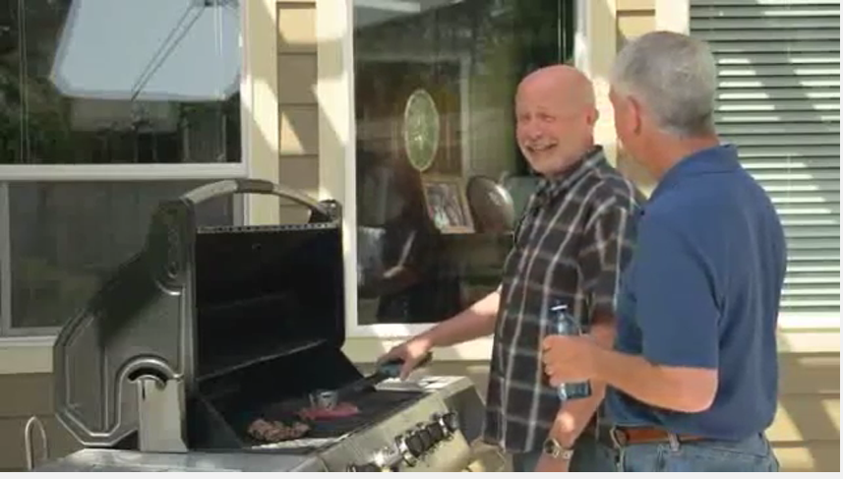
https://www.youtube.com/watch?v=5jq_DyiP1gg
This video is being used with the express permission of Sunset Memorial.
Notes:
Video

Slide 4
Notes:
Notes: Whether you choose cremation or not, preplanning your memorial and final disposition is a generous and caring gift to your loved ones. “Disposition” can be either cremation or full body burial. Importantly, for planning purposes, you must think about where you want your final resting place to be – where would your cremated remains be placed following a gathering of your family and friends.
We’ll look at preplanning and prefunding in more detail a little later in the presentation.
So for now, let’s start by recognizing that the rate of cremation has surpassed that of traditional burial n the US¹. The reasons for choosing cremation are varied and personal.
¹http://www.nfda.org/news/media-center/nfda-news-releases/id/1310/2016-nfda-cremation-and-burial-report-released-rate-of-cremation-surpasses-that-of-burial-in-2015

Slide 5
Notes:
Notes: Your service options are the same, enabling your family and friends to gather together, share stories, give eulogies and begin the healing process. A memorial service typically occurs after cremation is complete, with or without the cremated remains present.

Slide 6
Notes:
Notes: Urns can be made out of almost anything – wood such as oak, mahogany, cherry, maple or pine; metal such as pewter, bronze, copper or brass; biodegradable material; glass; marble; or ceramic. I can show you many options to personalize your final resting place.
The selection of an urn is important as it provides both a protective and unique container for your cremated remains. I can provide you with more information on available options.

Slide 7
Notes:
Funeral Home may include your unique offerings here.

Slide 8
Notes:
Notes: There are many options available for placement of your cremated remains. It’s important that you think about what will happen after cremation takes place and that you have a specific plan in mind for the remains so your family and loved ones aren’t left wondering what you would want them to do. Think about where you would like your urn to be in 15, 25 or 50 years. If you decide to have your cremated remains scattered. Communicate your preferences about where you’d like this done, so that your family can make the appropriate arrangements when the time comes.

Slide 9
Notes:
Funeral Home may include your unique offerings here.

Slide 10
Notes:
Notes: If you choose to be cremated, there are certain preauthorization forms you will need to complete to confirm your choice. We are able to provide those and help you complete them.

Slide 11
Notes:
Notes: The answer is yes. The federal government does not require that you have a traditional burial if you are a veteran and would like to take advantage of the burial benefits available through the U.S. Department of Veterans Affairs. You may be cremated and then interred at a national cemetery with available space. The United States Navy also offers burial at sea for retirees and veterans of the uniformed services who were honorably discharged.

Slide 12
Notes:
Notes: Yes. Just as you can plan and prefund a traditional burial and funeral service, you may also do so if you choose to be cremated. It may spare your family the financial burden of paying for your funeral arrangements.

Slide 13
Notes:
Notes: Paying for your funeral in advance can have a major effect on your Medicaid eligibility. In most states, an individual living in a nursing home can have only about $2,000 in “countable” assets in order to qualify for Medicaid benefits. For example, if you have $10,000 set aside to pay for your funeral, but have not actually prepaid or set it aside in an irrevocable trust, you will not be eligible to receive Medicaid benefits.

Slide 14
Notes:
Notes: A funeral service helps the bereaved begin to overcome their grief and offers family and friends the opportunity to honor a loved one. It fills an important emotional need for those close to you at the time of your death. Preplanning and prefunding relieves your family and friends of the burden of having to make difficult decisions at a stressful time. And you gain peace of mind, knowing that your expenses are covered and that you will be memorialized in a way that is meaningful to you.

