Slide 1
Notes:
Welcome to { name of location }. My name is { name } and I work with {ABC Funeral Home}. I’m here today to talk to you about an important, but difficult topic, funeral planning.

Slide 2
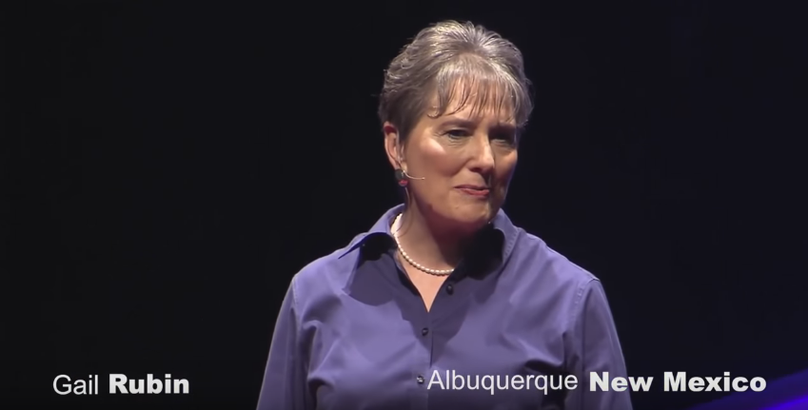
https://www.youtube.com/watch?v=r9qR4ZiGX2Y
Notes:
Insert information about the funeral home, the sales person or other details.

Slide 3
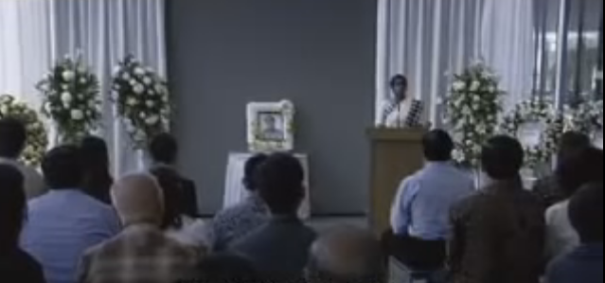
https://www.youtube.com/watch?v=2j_YGuQ-Da4
Notes:
Insert information about the funeral home, the sales person or other details.

Slide 4
Notes:
I recognize this isn’t an easy topic to talk about, and before we begin, I’d like to congratulate you on taking this step and recognizing how important a formalized plan is for you and your family.

Slide 5
Our Story
Funeral Home: Insert your images or text here.
Notes:
Insert information about the funeral home, the sales person or other details.

Slide 6
Notes:
There are many decisions to be made when a loved one passes away. Readings and flowers, music, caskets and pall bearers. When you plan ahead, you can make these decisions in advance sparing your loved ones from having to make these important decisions during one of the most difficult times of their lives.

Slide 7
Notes:
Pre-planning your funeral has many other benefits for you and your loved ones. By sharing your wishes now and leaving a plan, they don’t have to try guess what you would have wanted. Plus, you’ll have peace of mind knowing your plan is documented and reflects who you are. By planning ahead and funding your funeral in advance, you can save your loved ones from a financial burden as well.

Slide 8
Notes:
Whether you choose a burial or cremation, your plan should include key details such as viewing or visitation, graveside service, obituary information, music and readings … and anything else you feel is pertinent to your final wishes.

Slide 9
Notes:
So far we’ve talked about the importance of planning, which is a key first step. Another gift you can leave your loved ones is funding your services in advance, which has many benefits to you and to your loved ones.

Slide 10
Notes:
Funding a plan can help relieve your loved ones from a financial burden, as well as secure today's prices for the cost of your service and other purchases that will need to be made.
Money to pay the funeral home for your services will be available quickly, usually within 24 to 48 hours.

Slide 11
Notes:
It’s important to work with someone who is well versed in the funeral business as there are some important things you need to know about preplanning and funding your funeral plan, for example {read a few of these off the slide.}

Slide 12
Funeral and memorial planning is funded through the purchase of whole life insurance or an annuity from Forethought Life Insurance Company, Indianapolis, Indiana. A representative of our firm, who may also be an agent with Forethought Life Insurance Company, is available to answer any questions you may have regarding your insurance coverage. Products and features are subject to state variations and availability.
Notes:
As we saw at the beginning of this presentation, almost everyone in this room has planned for a major event in their life, whether it was a wedding or college education or a well-deserved vacation. Just by being here, you’ve shown that planning for your final wishes is equally important and I’m here to help you.

Slide 13
Notes:
And now, I’d like to answer any general questions you may have, but I will also be available after the presentation to speak with you personally to answer questions or schedule time to meet with you later.
Questions?
If your presentation includes a meal, you may change the script as follows:
- As you enjoy your lunch/dinner... I'll be coming around to talk to each of you about your wishes and will set up a time for us to help you get started on your personal planning.

Slide 14
PRE1136 (07-17) © 2017 Global Atlantic

